Slide 1
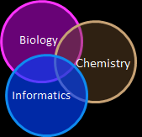

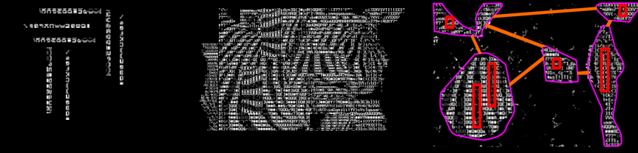
2015 Workshop on Statistics and Data Analysis for Metabolomics
Introduction
Dmitry Grapov, PhD
2015 Workshop on Statistics and Data Analysis for Metabolomics by Dmitry Grapov is licensed under a Creative Commons Attribution-NonCommercial-ShareAlike 4.0 International License.

Slide 2
Important
This is an introduction to a series of tutorials for metabolomic data analysis
Download all the required files and software at: TBD
Make sure you have installed R (≥v 3.1.1, http://cran.us.r-project.org/ ), shiny (v0.10.2.2, http://shiny.rstudio.com/ ) and a modern browser (e.g., Chrome).
Run the code in the folder software the file startup.R to launch all accompanying software; or download most current versions at the links below
DeviumWeb (https://github.com/dgrapov/DeviumWeb)
MetaMapR (https://github.com/dgrapov/MetaMapR)
Have a great time!
Introduction

Slide 3
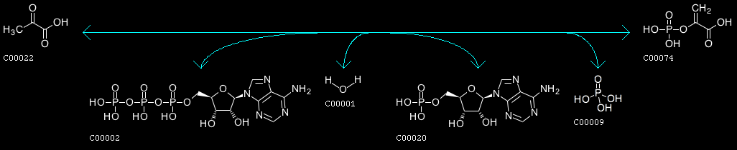
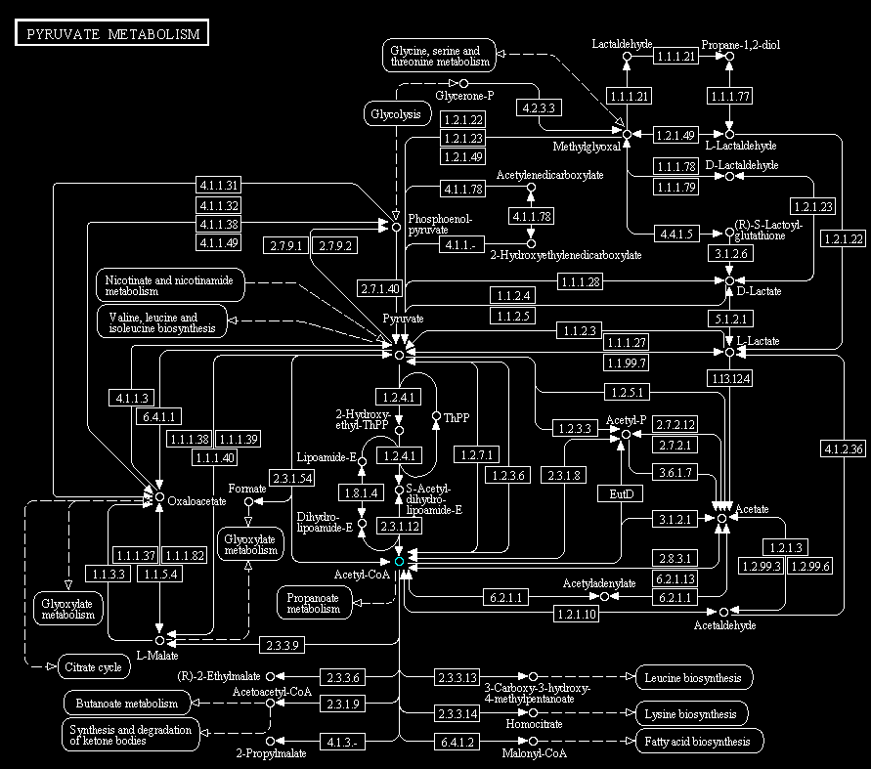
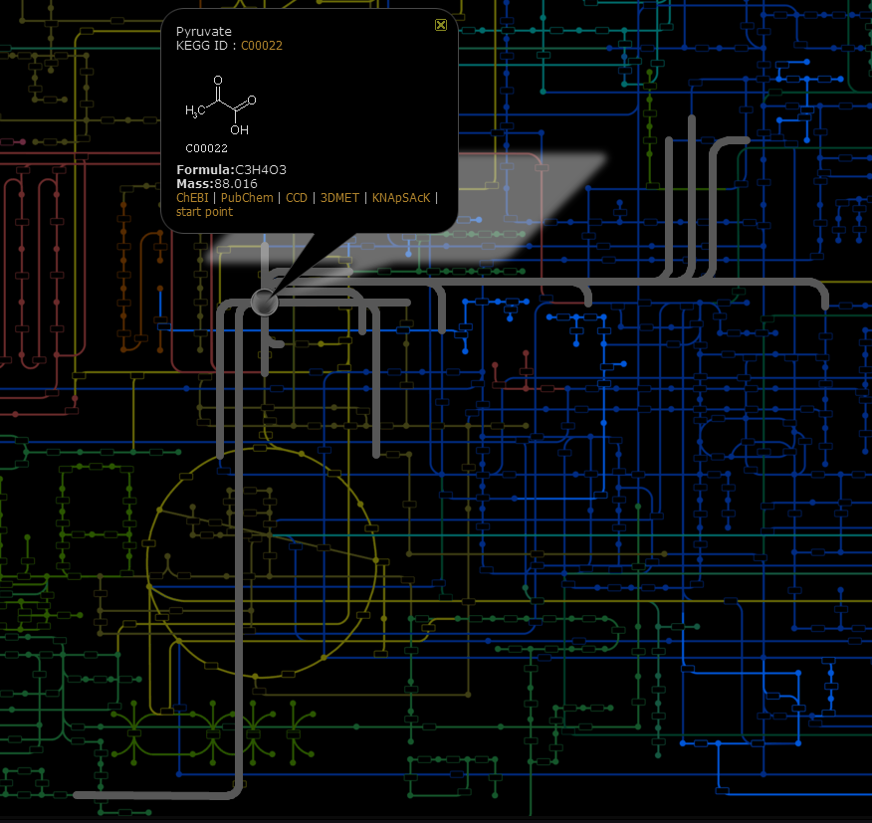
Goals?

Slide 4
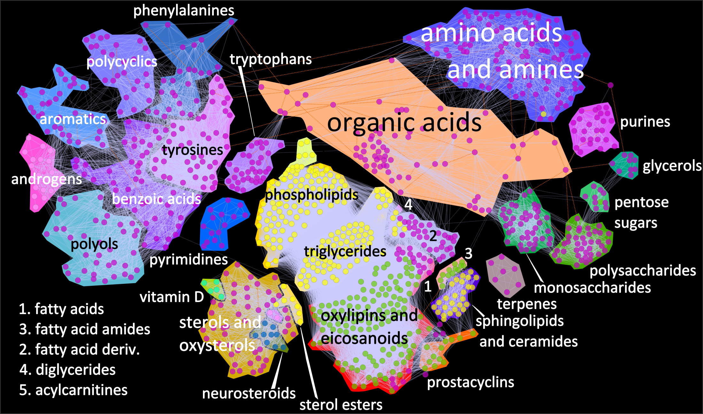
Analysis at the Metabolomic Scale

Slide 5
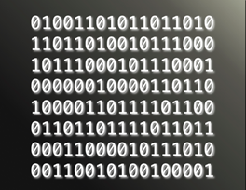
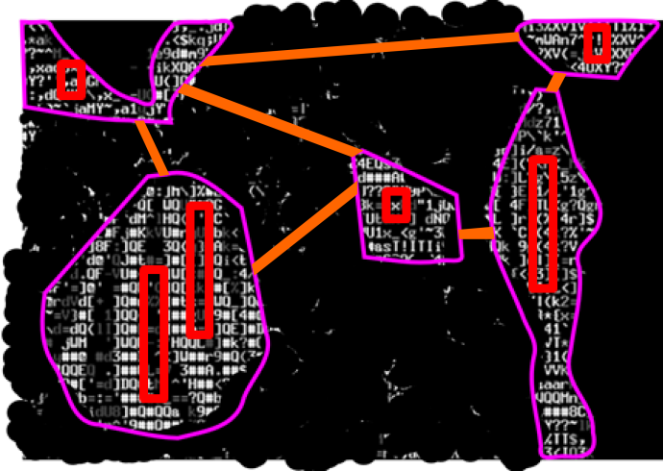

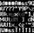
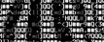
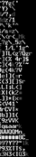
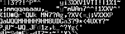
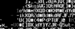
Statistical and Multivariate Analyses
Group 1
Statistics
What analytes are different between the two groups of samples?
+
Multivariate
Group 2
+
Context
=
Statistical
Multivariate
Network Mapping
t-Test
O-PLS-DA
significant differences lacking rank and context
ranked differences lacking significance and context
Ranked statistically significant differences within a a biochemical context

Slide 6
Statistical and Multivariate Analyses
Group 1
Statistics
What analytes are different between the two groups of samples?
+
Multivariate
Group 2
+
Context
=
Statistical
Multivariate
Network Mapping
t-Test
O-PLS-DA
To see the big picture it is necessary too view the data from multiple different angles

Slide 7


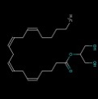
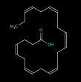
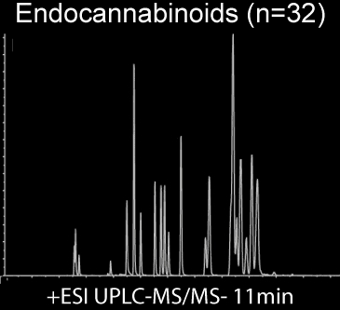
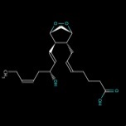
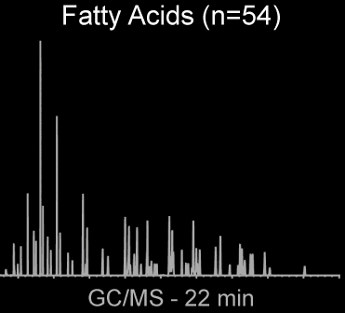
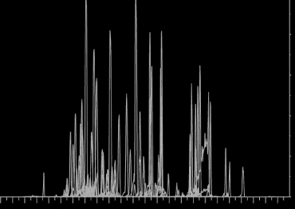

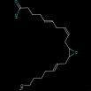
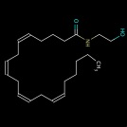
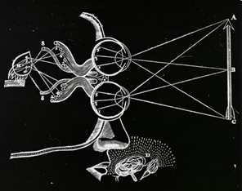
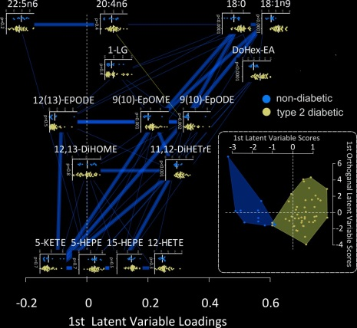
Cycle of Scientific Discovery
Hypothesis
Data Acquisition
Data Processing
Hypothesis Generation
Data Analysis
Data

Slide 8
Data
Analysis and Visualization
Variable
Quality Assessment
use replicated mesurements and/or internal standards to estimate analytical variance
Statistical and Multivariate
use the experimental design to test hypotheses and/or identify trends in analytes
Functional
use statistical and multivariate results to identify impacted biochemical domains
Network
integrate statistical and multivariate results with the experimental design and analyte metadata
Sample
Sample
Variable
experimental design
- organism, sex, age etc.
analyte description and metadata
- biochemical class, mass spectra, etc.

Slide 9
Data
Analysis and Visualization
Variable
Quality Assessment
use replicated mesurements and/or internal standards to estimate analytical variance
Statistical and Multivariate
use the experimental design to test hypotheses and/or identify trends in analytes
Functional
use statistical and multivariate results to identify impacted biochemical domains
Network
integrate statistical and multivariate results with the experimental design and analyte metadata
Network Mapping
Sample
Sample
Variable
experimental design
- organism, sex, age etc.
analyte description and metadata
- biochemical class, mass spectra, etc.

Slide 10
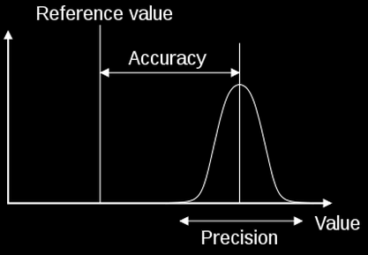
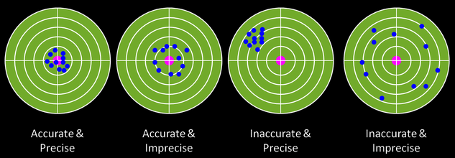
Data Quality Assessment
Quality metrics
Precision (replicated measurements)
Accuracy (reference samples)
Common tasks
normalization
outlier detection
missing values imputation
*Finish lab: 1-Data quality

Slide 11
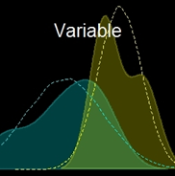
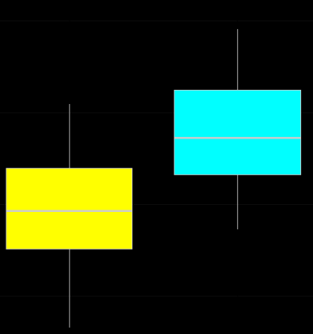
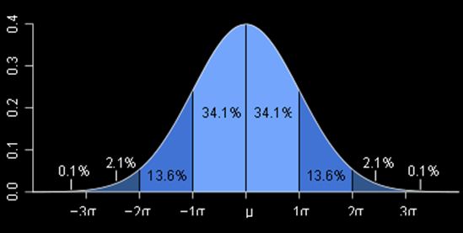
Univariate Qualities
length (sample size)
center (mean, median, geometric mean)
dispersion (variance, standard deviation)
range (min / max),
quantiles
shape (skewness, kurtosis, normality, etc.)
standard deviation
mean

Slide 12
Univariate Analyses
Identify differences in sample population means
sensitive to distribution shape
parametric = assumes normality
error in Y, not in X (Y = mX + error)
optimal for long data
assumed independence
false discovery rate (FDR)
wide
long
n-of-one

Slide 13
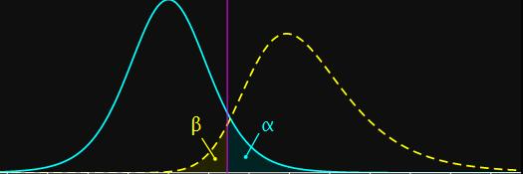
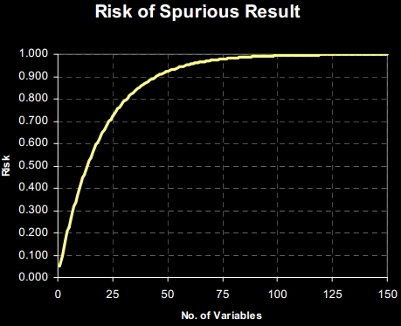
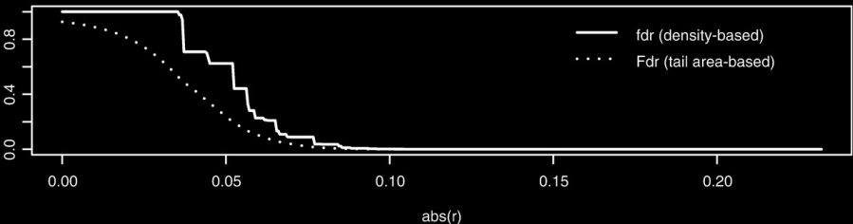
False Discovery Rate (FDR)
Type I Error: False Positives
Type II Error: False Negatives
Type I risk =
1-(1-p.value)^{m}
m = number of variables tested
FDR correction
p-value adjustment or estimate of FDR (Fdr, q-value)
Bioinformatics (2008) 24 (12):1461-1462

Slide 14
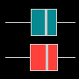
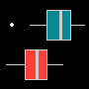
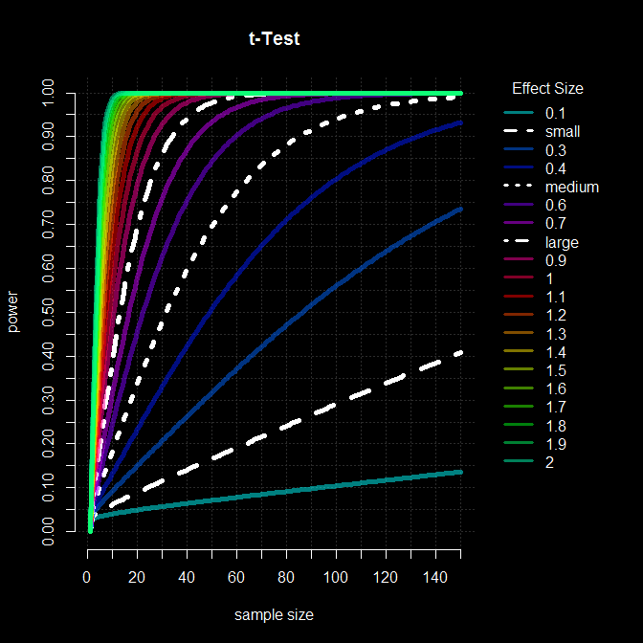
Statistical Analysis: achieving ‘significance’
significance level (α) and power (1-β )
effect size (standardized difference in means)
sample size (n)
Power analyses can be used to optimize future experiments given preliminary data
Example: use experimentally derived (or literature estimated) effect sizes, desired p-value (alpha) and power (beta) to calculate the optimal number of samples per group
*finish lab
2-statistical analysis

Slide 15
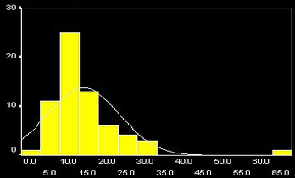
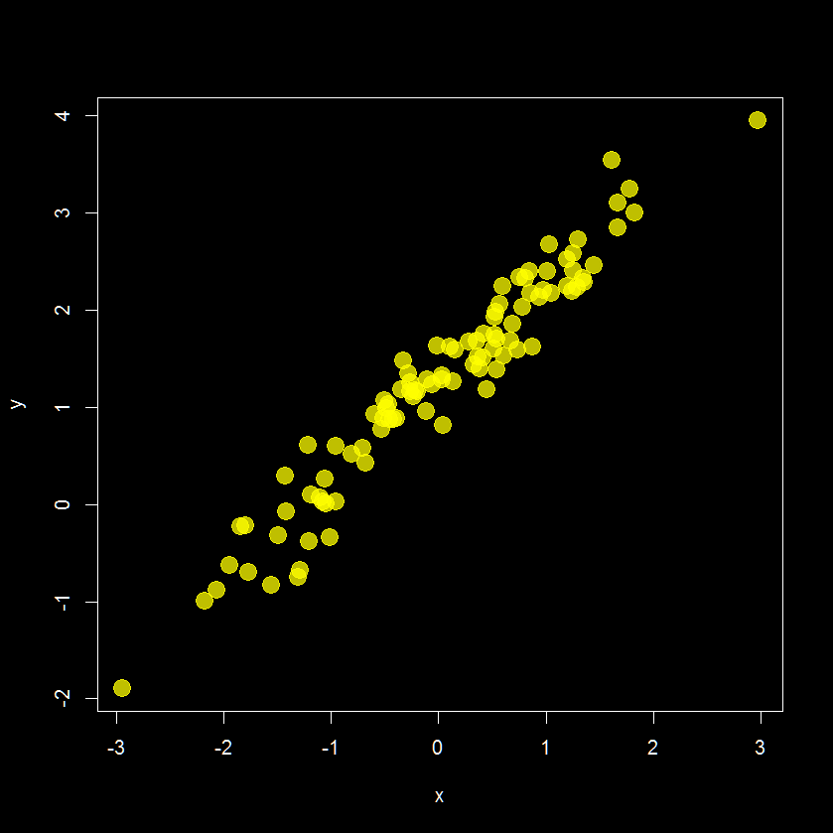
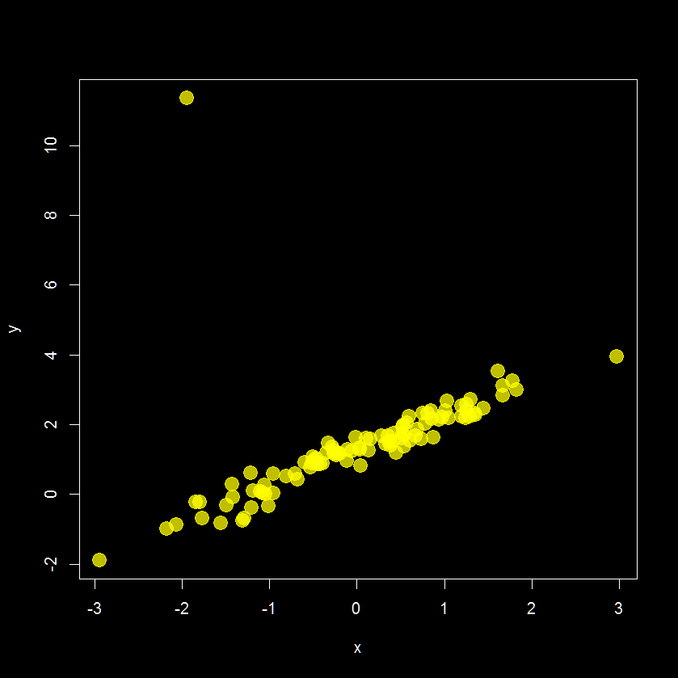
Outlier Detection
1 variable (univariate)
2 variables (bivariate)
>2 variables (multivariate)

Slide 16
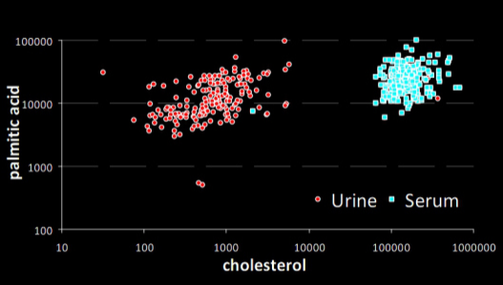
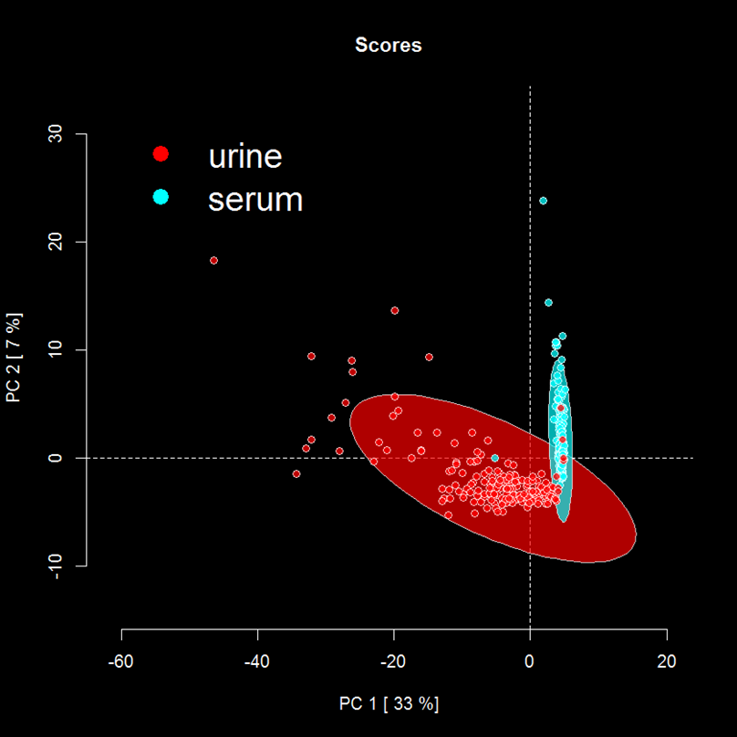
Outlier Detection
bivariate vs.
multivariate
(scatter plot)
(PCA scores plot)
outliers?
mixed up samples

Slide 17
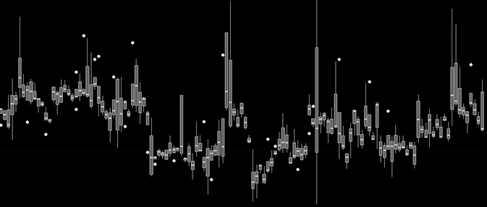
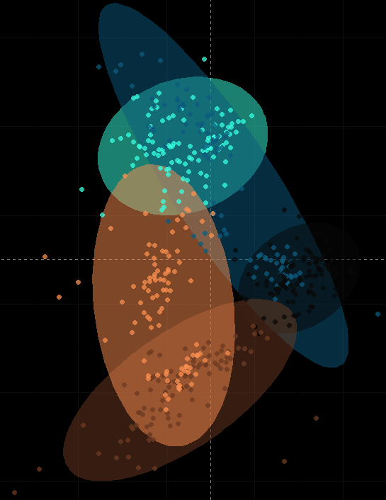
Batch Effects
Drift in >400 replicated measurements across >100 analytical batches for a single analyte
QCs embedded among >5,5000 samples (1:10) collected over 1.5 yrs
Abundance
Acquisition batch
Principal Component Analysis (PCA) of all analytes, showing QC sample scores
If the biological effect size is less than the analytical variance then the experiment will incorrectly yield insignificant results

Slide 18
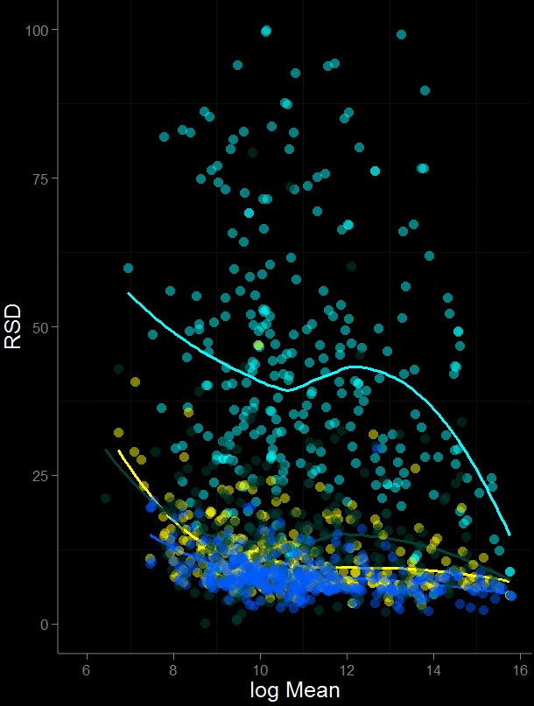
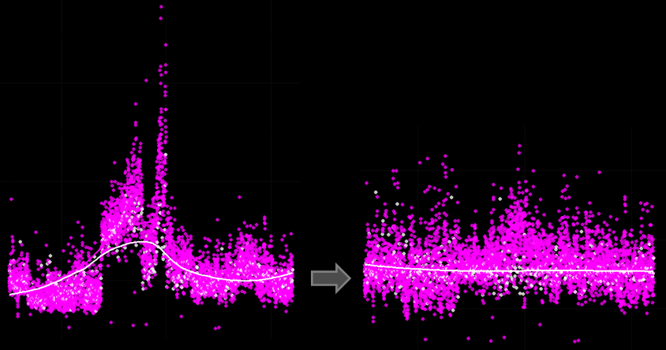
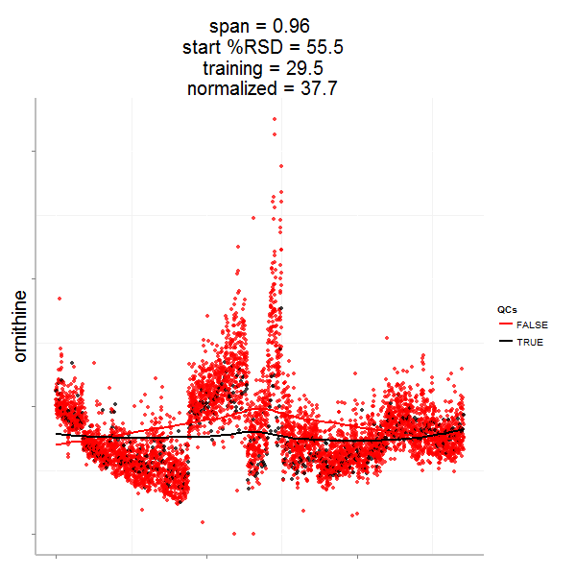
Batch Effects
Analyte specific data quality overview
Sample specific normalization can be used to estimate and remove analytical variance
Raw Data
Normalized Data
low precision
%RSD
Samples
QCs
high precision
log mean
*finish lab 3-Data Normalization

Slide 19

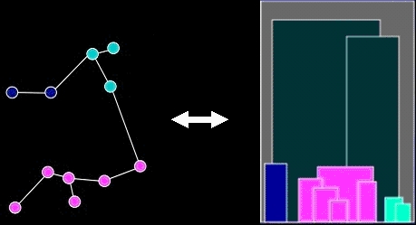
Clustering
Identify
patterns
group structure
relationships
Evaluate/refine hypothesis
Reduce complexity
Artist: Chuck Close

Slide 20
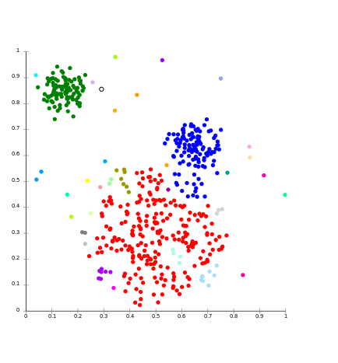
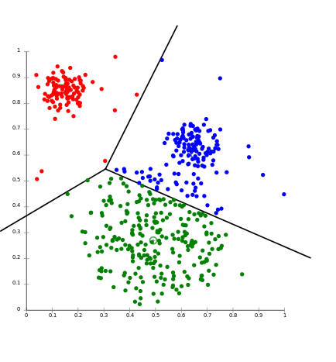
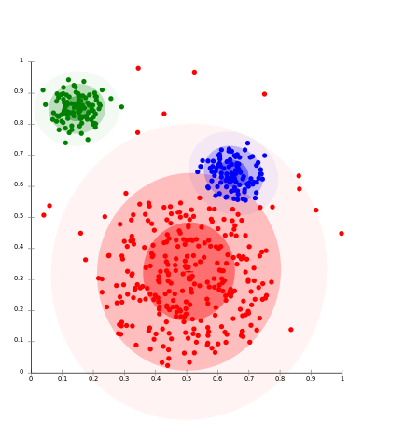

Cluster Analysis
Use the concept similarity/dissimilarity to group a collection of samples or variables
Approaches
hierarchical (HCA)
non-hierarchical (k-NN, k-means)
distribution (mixtures models)
density (DBSCAN)
self organizing maps (SOM)
Linkage
k-means
Distribution
Density

Slide 21
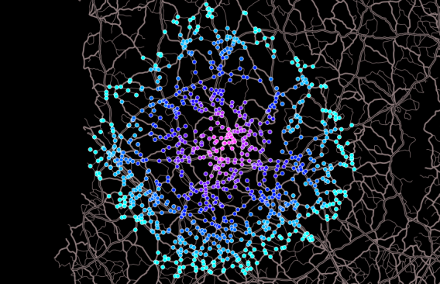
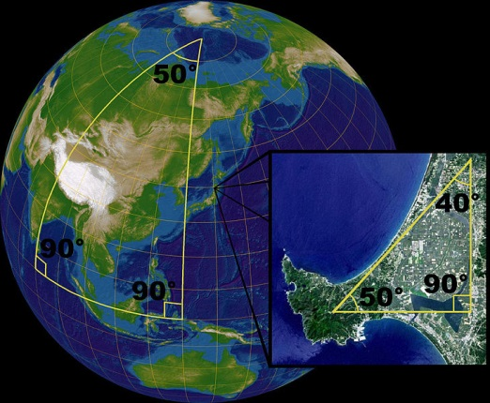
Hierarchical Cluster Analysis
similarity/dissimilarity defines “nearness” or distance
euclidean
manhattan
Mahalanobis
non-euclidean
X
X
X
*
Y
Y
Y

Slide 22

Hierarchical Cluster Analysis
Agglomerative/linkage algorithm defines how points are grouped
single
complete
centroid
average

Slide 23
Dendrograms
x
x
x
x
Similarity

Slide 24



Hierarchical Cluster Analysis
How does my metadata match my data structure?
Exploration
Confirmation
*finish lab 4-Cluster Analysis

Slide 25



Projection of Data
The algorithm defines the position of the light source
Principal Components Analysis (PCA)
unsupervised
maximize variance (X)
Partial Least Squares Projection to Latent Structures (PLS)
supervised
maximize covariance (Y ~ X)
James X. Li, 2009, VisuMap Tech.

Slide 26



Interpreting PCA Results
Variance explained (eigenvalues) Row (sample) scores and column (variable) loadings

Slide 27


How are scores and loadings related?

Slide 28




Centering and Scaling
*finish lab 5-Principal Components Analysis
PMID: 16762068

Slide 29


Use PLS to test a hypothesis on a multivariate level
Partial Least Squares (PLS) is used to identify maximum modes of covariance between X measurements and Y (hypotheses)
PCA
PLS
time = 0 120 min.

Slide 30


Modeling multifactorial relationships
~two-way ANOVA
dynamic changes among groups

Slide 31
PLS Related Objects
Model
dimensions, latent variables (LV)
performance metrics (Q2, RMSEP, etc)
validation (training/testing, permutation, cross-validation)
orthogonal correction
Samples
scores
predicted values
residuals
Variables
Loadings
Coefficients: summary of loadings based on all LVs
VIP: variable importance in projection
Feature selection

Slide 32



“goodness” of the model is all about the perspective
Determine in-sample (Q²) and out-of-sample error (RMSEP) and compare to a random model
permutation tests
training/testing
*finish lab 6-Partial Least Squares and lab 7-Data Analysis Case Study

Slide 33


Functional Analysis
Identify changes or enrichment in biochemical domains
decrease
increase
Nucl. Acids Res. (2008) 36 (suppl 2): W423-W426.doi: 10.1093/nar/gkn282

Slide 34







Functional Analysis: Enrichment
Biochemical Pathway
Biochemical Ontology
*finish lab 8-Metabolite Enrichment Analysis

Slide 35







Connections and Contexts
Biochemical (substrate/product)
Database lookup
Web query
Chemical (structural or spectral similarity )
fingerprint generation
BMC Bioinformatics 2012, 13:99 doi:10.1186/1471-2105-13-99
Empirical (dependency)
correlation, partial-correlation

Slide 36



Network Mapping
1. Calculate Connections
2. Calculate Mappings
3. Create
Mapped Network
Grapov D., Fiehn O., Multivariate and network tools for analysis and visualization of metabolomic data, ASMS, June 08, 2013, Minneapolis, MN

Slide 37








Mapping Analysis Results to Networks
Analysis results
Network Annotation
Mapped Network
*finish lab 9-Network Mapping I

Slide 38



Biochemical Relationships
http://www.genome.jp/dbget-bin/www_bget?rn:R00975

Slide 39



Structural Similarity
http://pubchem.ncbi.nlm.nih.gov//score_matrix/score_matrix.cgi

Slide 40

Correlation networks
simple to calculate
Complex lipids correlation network in mouse serum

Slide 41

Correlation Networks
can be difficult to interpret
poorly discriminate between direct and indirect associations
Complex lipids correlation network in mouse heart tissue

Slide 42


Partial correlations can help simplify networks and preference direct over indirect associations.
10.1007/978-1-4614-1689-0_17
Complex lipids partial correlation network in human plasma

Slide 43


Mass Spectral Connections
*finish lab 10-Network Mapping II
Watrous J et al. PNAS 2012;109:E1743-E1752

Slide 44
Software and Resources
DeviumWeb- Dynamic multivariate data analysis and visualization platform
url: https://github.com/dgrapov/DeviumWeb
imDEV- Microsoft Excel add-in for multivariate analysis
url: http://sourceforge.net/projects/imdev/
MetaMapR- Network analysis tools for metabolomics
url: https://github.com/dgrapov/MetaMapR
TeachingDemos- Tutorials and demonstrations
url: http://sourceforge.net/projects/teachingdemos/?source=directory
url: https://github.com/dgrapov/TeachingDemos
Data analysis case studies and Examples
url: http://imdevsoftware.wordpress.com/

Slide 45



Questions?
dgrapov@gmail.com
Notes:
45

